Slide 1
World War II: It Begins
(Map 1 - 1936)

Slide 2
The Austrian Anschluss
In 1937 Hitler called for the unification of the German people (Hitler wants more land)
First place: Austria
Hitler announces the “union” of Austria and Germany

Slide 3
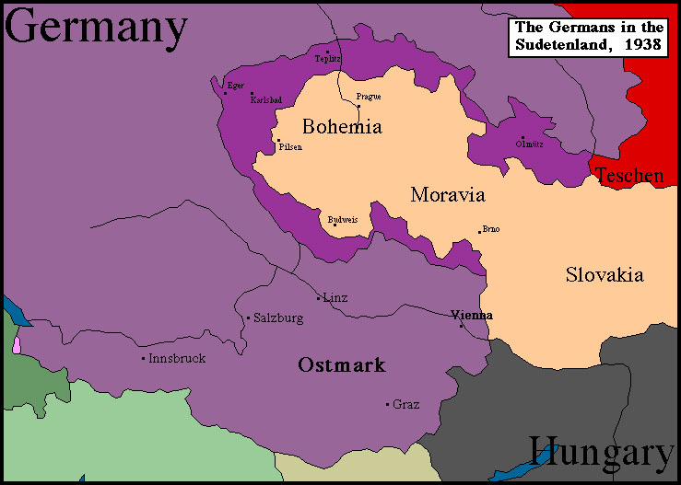
Hitler’s Demands
Hitler next demands the Sudetenland, an area of Czechoslovakia with a large Germany-speaking population

Slide 4
The Munich Agreement
European leaders start worrying
Representatives of Britain, France, Italy, and Germany agreed to meet in Munich to decide Czechoslovakia’s fate (the Munich Conference)
Appeasement: agreed to Hitler’s demands
Concessions in exchange for peace
Why?
Hitler has few demands – give him what he wants and we can avoid war

Slide 5
British Prime Minister: Neville Chamberlain
Neville Chamberlain:
Returning home, he promised “a peace with honor, a peace in our time”
Churchill, very upset:
“Britain and France had to choose between war and dishonor. They chose dishonor. They will have war.”

Slide 6
Primary Source Activity
Document A & B (Pages 2-3 in Doc Book)
Read each document and answer the corresponding questions on your notes.
Appeasement Hypotheses –
#1 – Write a paragraph answering Hypotheses #1

Slide 7
The Nazi-Soviet Pact
Non-aggression pact: August 1939
Germany and Russia promised never to attack each other
Another pact (secret) to divide Poland between them

Slide 8
Map 2: 1938

Slide 9
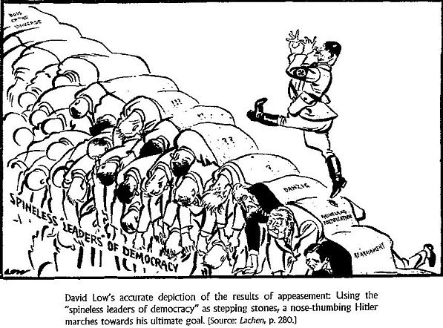
The German Offensive Begins
Did appeasement work?
In March 1939, Hitler takes over the rest of Czechoslovakia
Hitler invaded Poland on September 1, 1939.
Two days later Britain and France declared war.

Slide 10
A. Blitzkrieg in Poland
Blitzkrieg – lightning war
Tanks, artillery, and soldiers, moving by truck instead of on foot, rapidly struck deep into enemy territory before the enemy could react.
German troops took Poland in less than a month.
This was used to also take Denmark, Norway, Belgium, the Netherlands, and France.

Slide 11
Map 3: Sept 1939

Slide 12
The Phony War
For several months afterward, war was at a standstill along the Maginot Line along the French Border.
Called the “phony war” because no one fought for several months.
Suddenly, on April 9, 1940, Hitler launched a surprise invasion of Denmark and Norway
He next turned to Belgium and the Netherlands, which he overtook by the end of May

Slide 13
Map 4: April 1940

Slide 14
Map 5: May 1940

Slide 15
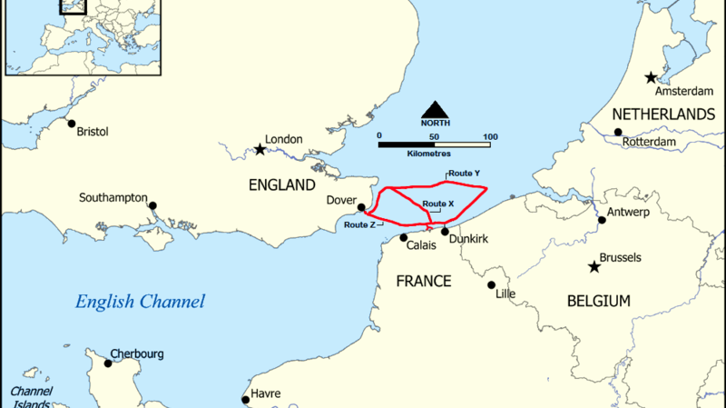
Dunkirk Evacuation
Take notes on the story...
Troops landed in England from Dunkirk,
Beach Harbor Total
27 May – 7,669 7,669
28 May 5,390 11,874 17,804
29 May 13,752 33,558 47,310
30 May 29,512 24,311 53,823
31 May 22,942 45,072 68,014
1 June 17,348 47,081 64,429
2 June 6,695 19,561 26,256
3 June 1,870 24,876 26,746
4 June 622 25,553 26,175
Totals 98,671 239,555 338,226

Slide 17
France and Britain fight on

Slide 18
The Fall of France
Germans came through Belgium to attack France
British and French troops barely escape
Italy joins on the side of Germany and invades France from the South
France was quickly overtaken

Slide 19
Map 6: June 1940

Slide 20
The Battle of Britain
Hitler tried to use the Luftwaffe (Air Force) to destroy Britain’s ability to resist.
1,000 planes a day bombed Britain.
RAF pilots flew as many as six and seven missions a day.
“Never in the field of human conflict was so much owed by so many to so few.”

Slide 21
HOMEWORK
Read Documents C, D & E and Complete the questions in your notes.
Complete Hypotheses #2 using what you’ve learned from Docs C, D & E.
Documents can be found on my website...OR you can take a Picture of them from the Doc Book on pages 4-5.

