Slide 1
Crash of the Stock Market

Slide 2
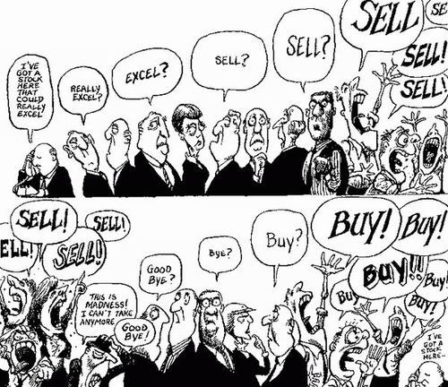
What is the Purpose of Stock?
In exchange for giving up a tiny fraction of control, businesses are given cash to expand.

Slide 3
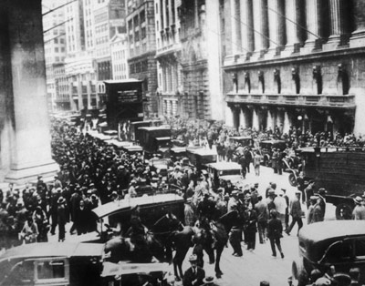
Stock Market Crash
Bull Market: long period of rising stock prices
Bull markets lasts only as long as investors continue putting new money in it.
By the latter half of 1929, the market was running out of new customers

Slide 4
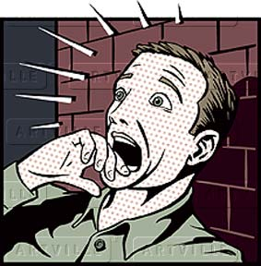
September 1929
Professional investors sensed danger and began to sell off their holdings.
Prices slipped
Other investors sold shares to pay interest on their brokerage loans
Prices fell further

Slide 5
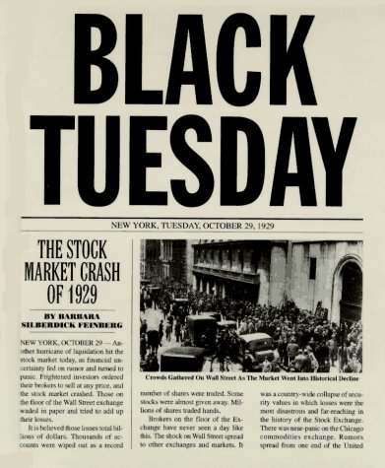
Black Tuesday
Prices took the steepest dive yet
16 million shares of stock were sold
The market lost between $10 billion and $15 billion dollars in value
Some people lost their whole fortunes
The crash undermines the economy’s ability to overcome other weaknesses

Slide 6
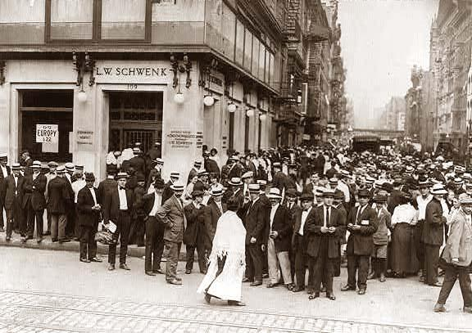
Financial Collapse
Because the stock market crashes, the overall financial industry in America collapses
Remember, in economies all the industries are intertwined

Slide 7
Bank Failures
By 1929 banks had loaned $6 billion to stock speculators
When stock values collapsed, banks lost money on their investments, and speculators could not pay back their loans
Banks suffered serious financial losses, so they drastically cut back on the loans they made
Now with less credit available, people couldn’t borrow or spend as much money. This put the economy in a recession
Some banks couldn’t recover from the losses and had to close
By 1932, nearly 3,500 banks closed (more than ten percent of the nation’s banks)

Slide 8
Run on Banks
At this time, the government did not insure bank deposits
So, if a bank collapses, customers (even if the didn’t invest in the stock market) lost their money
News of bank failures worried Americans
Bank Run: many people withdraw their money all at the same time
If too many people withdraw their money, the bank will collapse

Slide 9
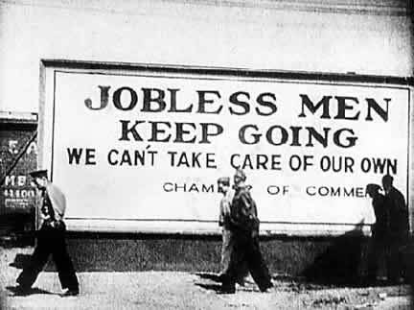
Business Failures
Common attitude now was, “If you didn’t need it, you didn’t buy it.”
Businesses rely on people buying their product. If people aren’t buying the businesses aren’t going to survive.
By 1932, at least 30,000 businesses close
By the end of the Great Depression, 80,000 close

Slide 10
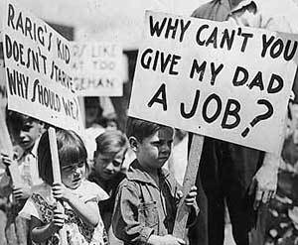
Unemployment
At the height of the Great Depression, 25% of working people were unemployed.
We are facing tough times today in our economy, but are unemployment rate is at about 12%.
Just like today, during the Great Depression, some places were higher in unemployment and some were lower

Slide 11
Steps to Financial Collapse
1. People stop spending
2. Businesses produce less
3. Layoffs/unemployment
4. More people stop spending

