Slide 1
Roots of the Great Depression
How did the 20’s lead to the Great Depression?
Students should be able to identify the underlying economic conditions that existed prior to the Great Depression. i.e Smoot Hawley Tariff, overproduction, buying on margin, credit, farm failures.

Slide 2
Remember the 1920s?
ROARING! – Prosperity and development!
New Technologies that changed lifestyles
Updated homes – electricity, radios, refrigerators, electric appliances, telephones are now everyday life!
Cars are becoming more affordable – THANKS HENRY FORD!
The GOOD TIMES were here to STAY!

Slide 3
But What CAUSED the Great Depression??

Slide 4
Important Industries
US prosperity depended on certain industries – but they began to decline in the 20s hurting the economy
Railroad Industry because of cars.
Housing production because less immigration
Steel production because the war is over
Textile production because the war is over
Coal production because oil and gas are being used

Slide 5
Uneven Distribution of Income
1929 the top 5% of American households earned 30% of the nation’s income
About 2/3 of families earned less than $2,500 a year

Slide 6
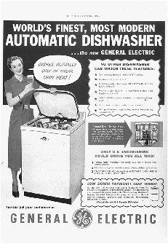
Living on Credit
Installment plans – (buying on credit)
Buyers could put a small down payment and make small monthly installments.
Paying off these debts eventually forced people to STOP buying because they had too many bills
Decrease in sales caused manufacturers to cut production and lay off employees.

Slide 7
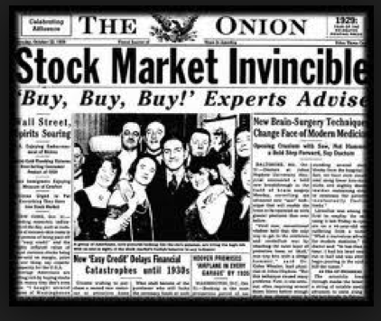
Speculation
Assumed that the market would ALWAYS go up
Betting on the fact that the stocks will never fail – only raise!

Slide 8
Buying on Margin
Refers to investing in Stocks
You pay small percent of money and then an investor covers the rest
This works only if stocks always increase – because at any time, you can sell your stock and pay off your loan and STILL MAKE MONEY!
If stocks drop – your investor will immediately want their money and you will be in debt

Slide 9
Hoover: 1928
“We are nearer to final triumph over poverty than ever before in the history of our land.”
“No fears for the future...it is bright”
How do those quotes, coming from the POTUS, effect Americans decisions or behaviors?

