Slide 1
Rise of the Dictators

Slide 2
Vocabulary Terms
Democracy. government by the people; a form of government in which the supreme power is vested in the people and exercised directly by them or by their elected agents under a free electoral system
Nationalism - Extreme pride in one’s own nation; desire for independence. Complete devotion to one’s nation.
Totalitarian Rule - Totalitarian governments use terror to suppress individual rights and to silence all forms of opposition.
Fascism - Political philosophy based on nationalism and an all-powerful state. Places importance of state over the importance of individuals. Everyone works for the benefit of society and the nation.
Socialism - Political theory that society as a whole should control the means of production, such as factories and the land. Wealth should be distributed to everyone. People should cooperate, not compete, in producing goods.
Communism - In the theories of Marx and Engels, a society without class distinctions or private property. All society jointly owns the nation’s means of production. Characterized by complete government ownership of land and property, single-party control of the government, the lack of individual rights, and the call for worldwide revolution.

Slide 3
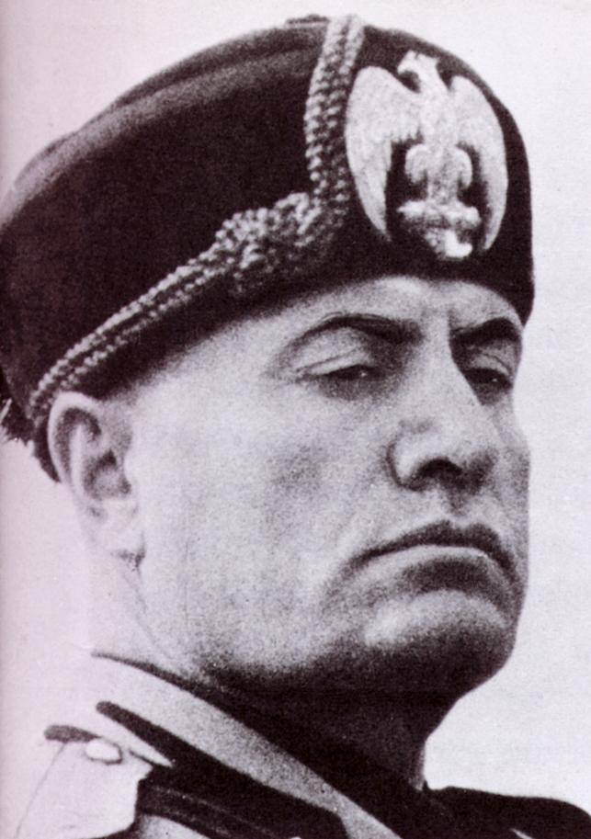
Italy
One of the 1st Dictatorships
Benito Mussolini
Founded Italy’s Fascist Party
Pledged to return Italy to Glory days of Roman Empire
Promised Working Class full employment and social security

Slide 4
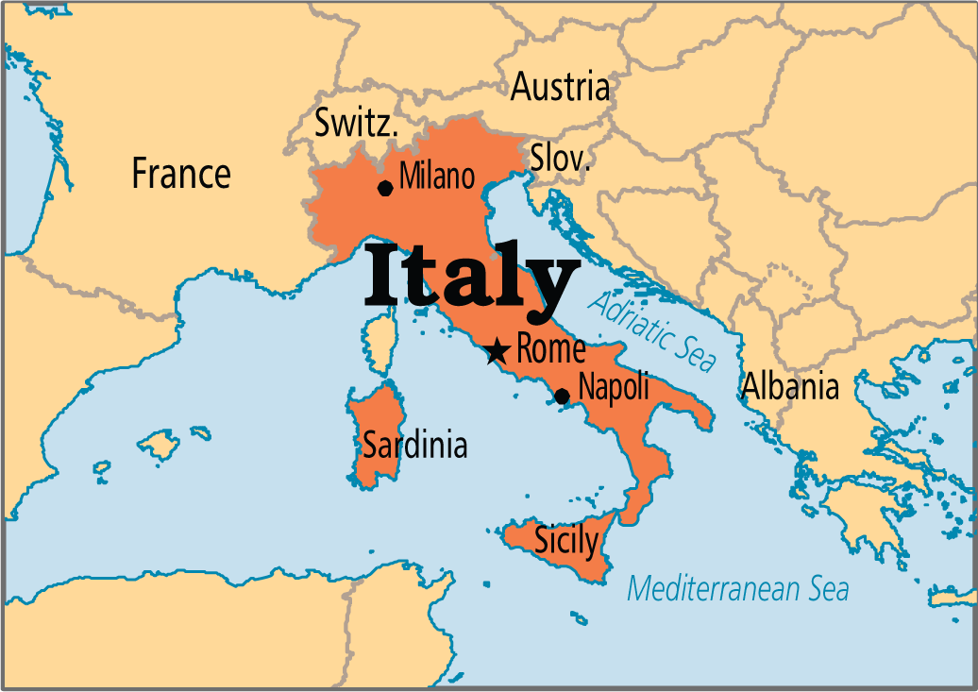
Italy
Fascism
Aggressive NATIONALIST – considered the Nation more important than the individual
Nations become great through building an empire – MORE LAND
ANTI – COMMUNIST

Slide 5
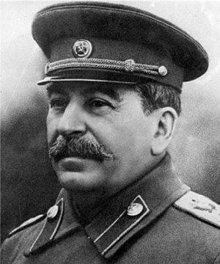
Russia
After Russia Revolution – Communist Party led by Vladimir Lenin
Renamed USSR in 1922 (Union of Soviet Socialist Republics)
Stalin
1902 – 1913 – imprisoned or expelled 7 times
1926 – becomes Russian Soviet Dictator
Begins massive industrialism in Russia – harsh conditions and lower wages
Tolerated no opposition

Slide 6
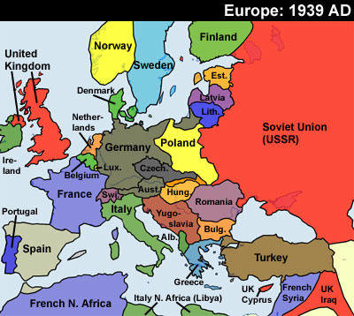
Russia
Communism
Instituted one- party rule
Suppressed individual liberties
Punished opponents

Slide 7
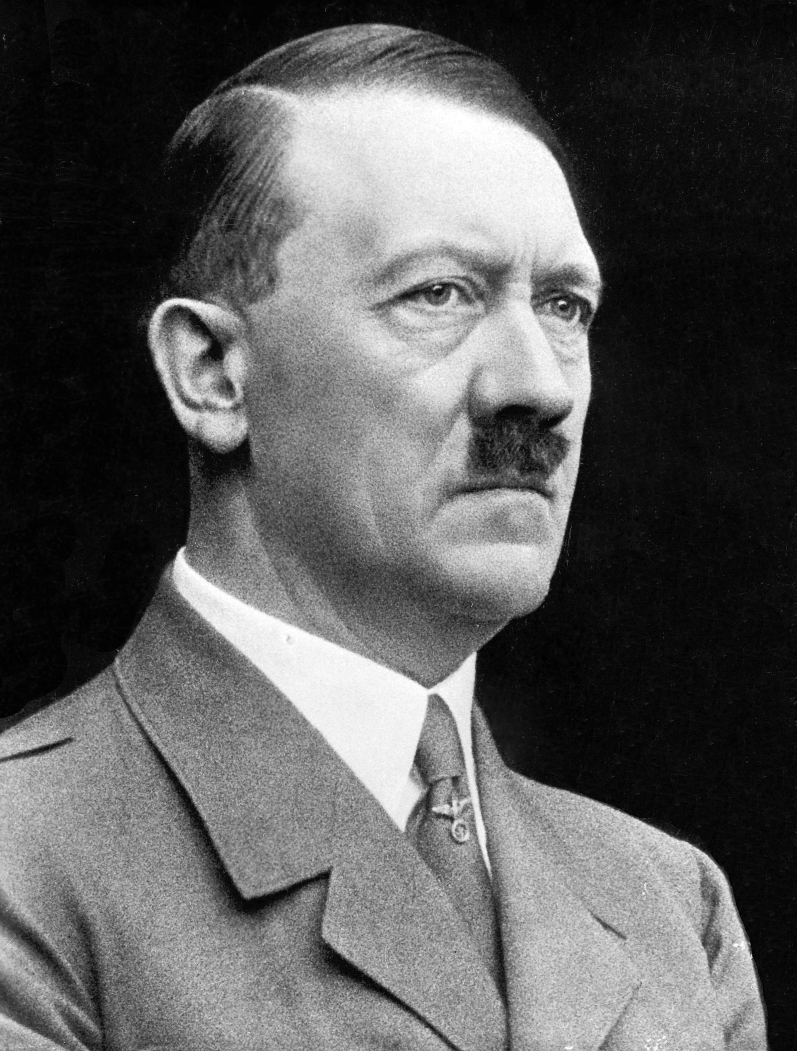
Germany
Upset at the Treaty of Versailles
Horrible economy
Hitler
One of the 1st recruits for Nazi Party
1923 – tried to seize power – failed – jailed
Wrote Mein Kampf –
Aryans are master race, blue eyes, blonde hair, we didn’t deserve what we got after WWI, etc.
Appointed Chancellor – called for new elections and he won!

Slide 8
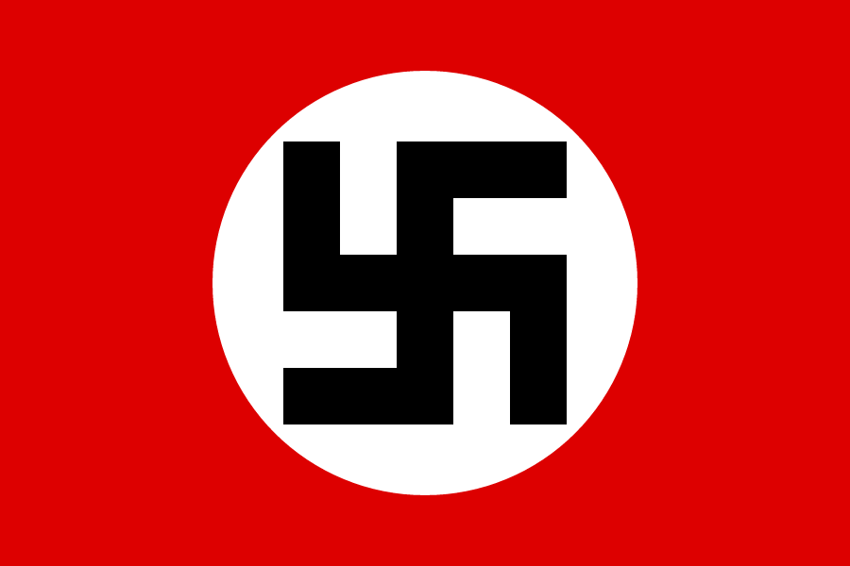
Germany
Nazi Germany
Anti – Communist
Didn’t follow the treaty
Wanted to expand Germany
Intimidated voters
People followed because it gave them hope and many promises given

Slide 9
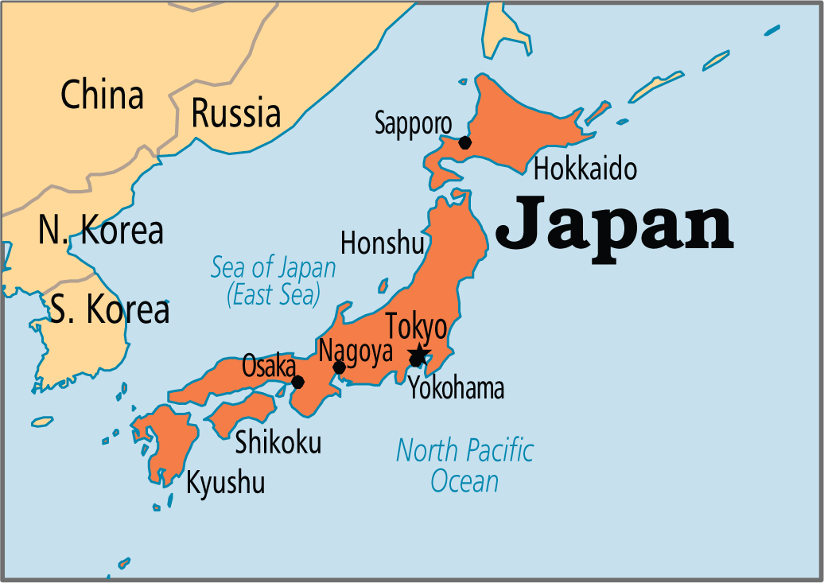
Japan
Difficult economic times
Japan had to import all goods but they couldn’t afford them
Started tariffs but that backfired too
Blamed corrupt politicians – said democracy was bad and was ‘un-Japanese”

Slide 10
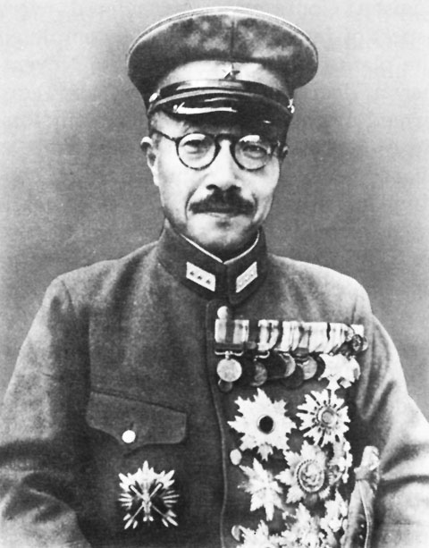
Japan
Only way to survive would be to invade and get more land
1931 – invaded Manchuria (North China)
Japanese Prime Minister interfered, Japan officers assassinated him
From that point forward – Military controlled the government. Led by General Tojo

Slide 11
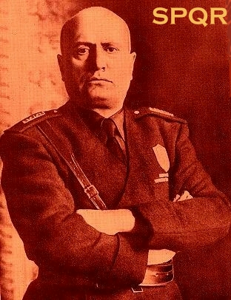
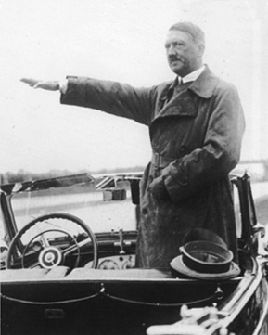
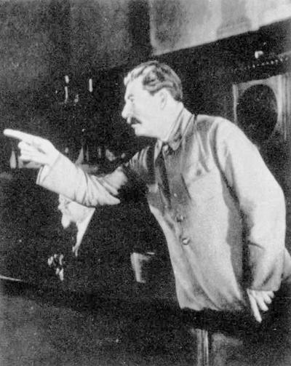
The Faces of Totalitarianism
Fascist Italy
Extreme nationalism
Militaristic expansionism
Charismatic leader
Private property with strong govt controls
Anticommunist
Nazi Germany
Militaristic expansionism
Forceful leader
Private property with strong govt controls
Anticommunist
Communist Soviet Union
Create a sound communist state and wait for world revolution
Revolution by workers
State ownership of property

