Slide 1
A Flawed Peace
WWI

Slide 2
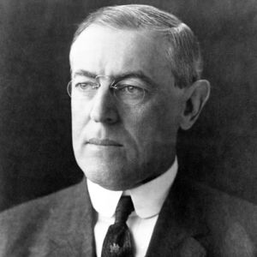
A Flawed Peace
President Wilson is optimistic that the war is over and peace is possible!

Slide 3
Armistice
Agreement to stop fighting
WWI → 11 month, 11th day, 11th hour
(Veteran’s Day)

Slide 4
The Fourteen Points
Wilson’s Peace Plan
He believed if these points were followed, peace would last.
America struggled to support him and believe it would work...Wilson was going to have to sell it
Self-Determination
League of Nations

Slide 5
National Self-Determination
Borders should be based on ethnicity and national identity –
Everyone can government themselves!
basically group people who feel they are a nation and allow them to build their own country.

Slide 6
League of Nations
A “General Association of Nations”
Member nations help preserve peace by pledging to respect and preserve each other’s territory and political independence.

Slide 7
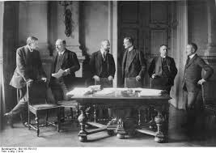
The Treaty of Versailles
The Treaty was signed in June 1919
Officially ended the war.

Slide 8
Peace Conference in Paris
Designed to create peace
Who attended?
USA – Wilson
Great Britain – King George
France – George Clemenceau
Italy – Vittorio Orlando
Germany – Not Invited!

Slide 9
Punishment for Germany
Most leader thought that Germany should be blamed for the war (they built up their military first)
Germany must....
Take all responsibility of the war
Pay Reparations
Less land
Reduce military and limits on Navy (100,000 men)

Slide 10
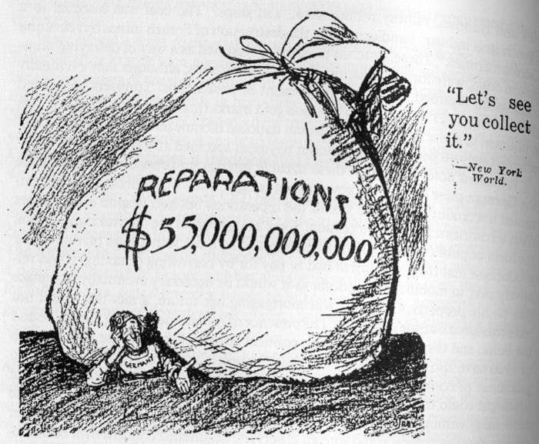
Reparations
Germany was required to pay back $33 Billion dollars to the US
Finally paid it off in 2010

Slide 11
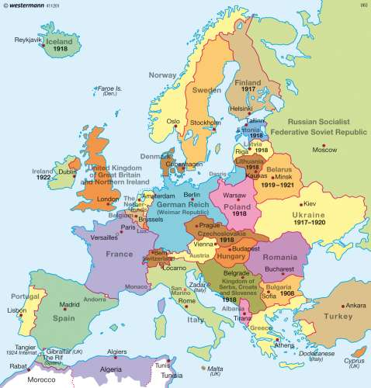

Slide 12
Set-up for WWII
Germany didn’t have money to pay back
Their economy fails horribly
Worse economic situation for Germany than America during the Great Depression
Germany is poor, desperate, and humiliated...

Slide 13
Other Facts
9 new nations are created after WWI
i.e. Austria, Czechoslovakia, Estonia, Finland, Hungary

Slide 14
Should We Sign This Treaty?
FOR
Most liked the treaty except the League of Nations...wanted the League amended

Slide 15
AGAINST
Believed the treaty made the U.S become too involved in world affairs
Potentially would force us in future European issues.
Most Americans wanted to return to isolationism.

Slide 16
Read Primary Sources

Slide 17
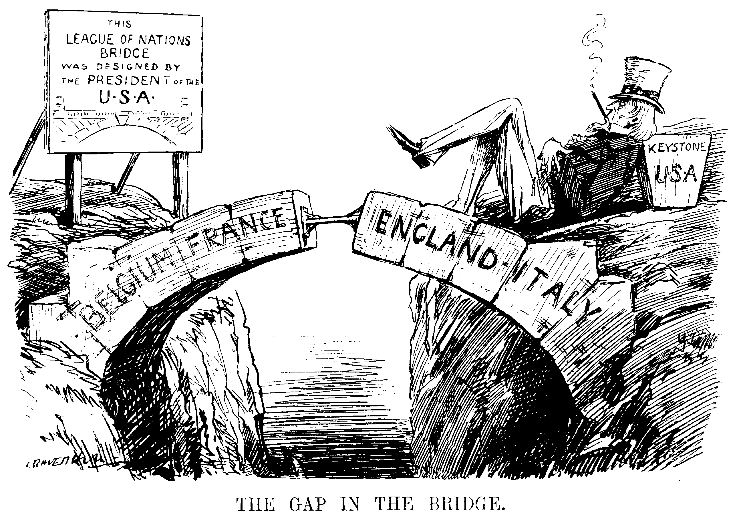
OUTCOME
U.S. Senate rejected the treaty
Made it hard for the League of Nations to be successful without the US backing them.

