Slide 1
Battle of Britain: Summer and Fall of 1940
German aircraft losses: 1,500 +
British aircraft losses: 1,000 +
German casualties: 3,000 + (KIA/MIA)
British casualties: 400 + (Killed/MIA)

Slide 2
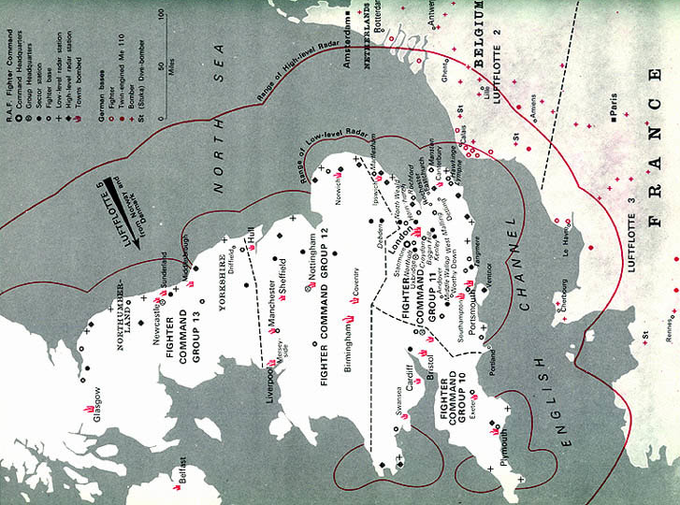
Map of Great Britain
1

Slide 3
Battle of Stalingrad: Summer of 1942- February 1943
Germany: 750,000 killed, wounded or missing; 108,000+ captured
900 aircraft; 4,300 tanks
Soviet Union: 1,129,000 killed, wounded, missing or captured 1,000 to 40,000 civilians killed 2,769 aircraft; 4,340 tanks

Slide 4
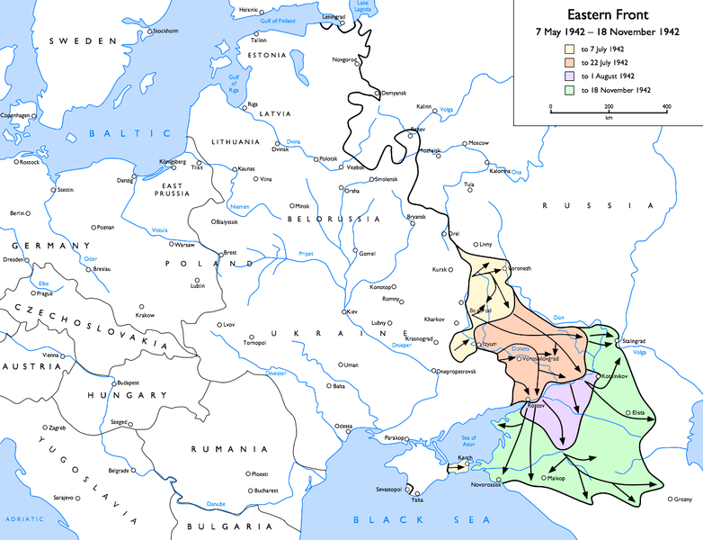
Stalingrad Map
1

Slide 5
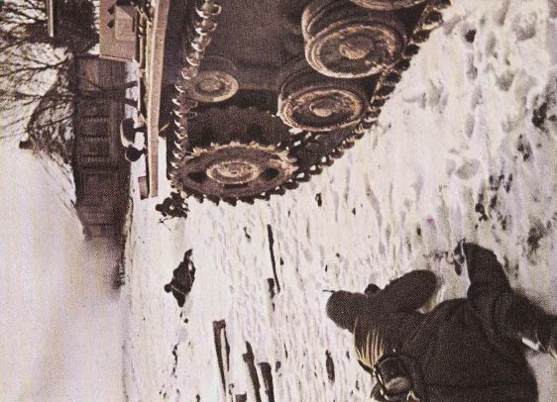
Fighting in Winter
3

Slide 6
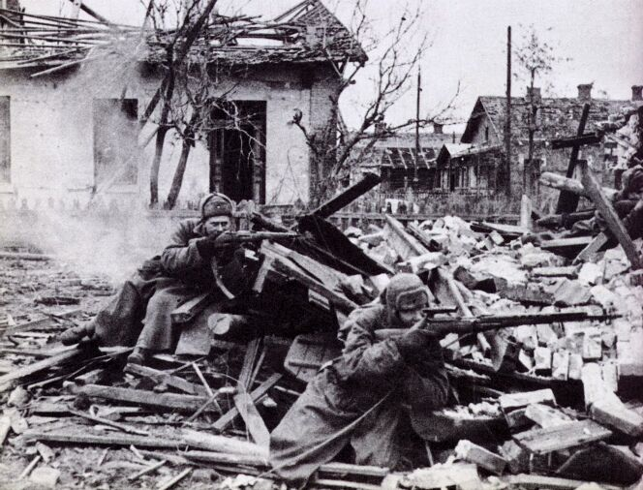
Stalingrad Snipers
4

Slide 7
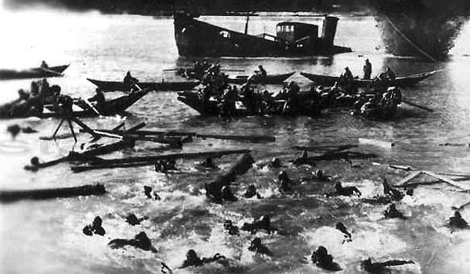
Crossing the Volga River
5

Slide 8
D-Day: June 6, 1944
Allied casualties: 9,000 +
German casualties: 4,000-9,000

Slide 9
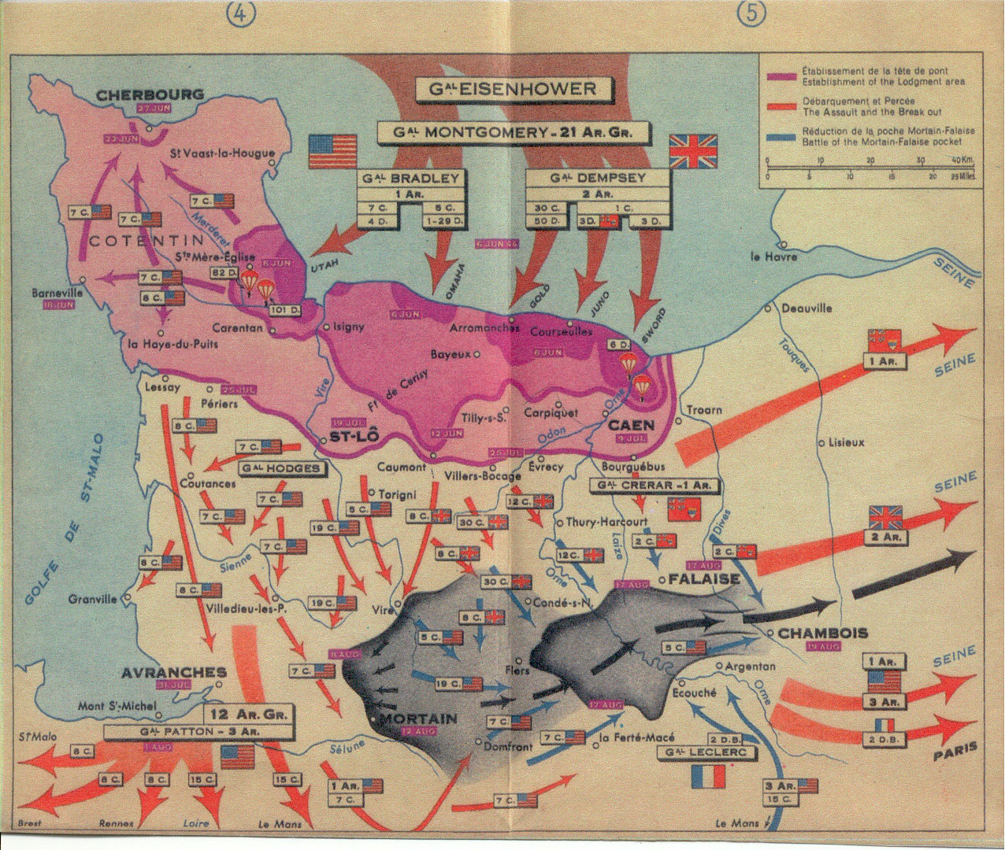
Map of the D-Day Attack
1

Slide 10
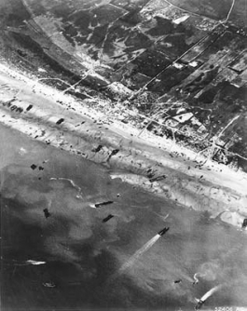
Areal view of the beaches
4

Slide 11
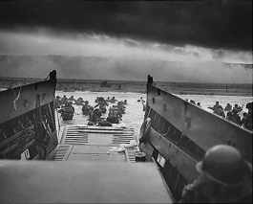
View from the eyes of a soldier
5

Slide 12
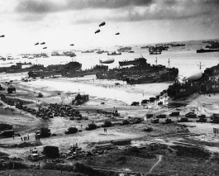
The Beaches of Normandy
6

Slide 14
Battle of the Bulge: December 1944- January 1945
German casualties: 100,000 +
Allied casualties: 81,000 +

Slide 15
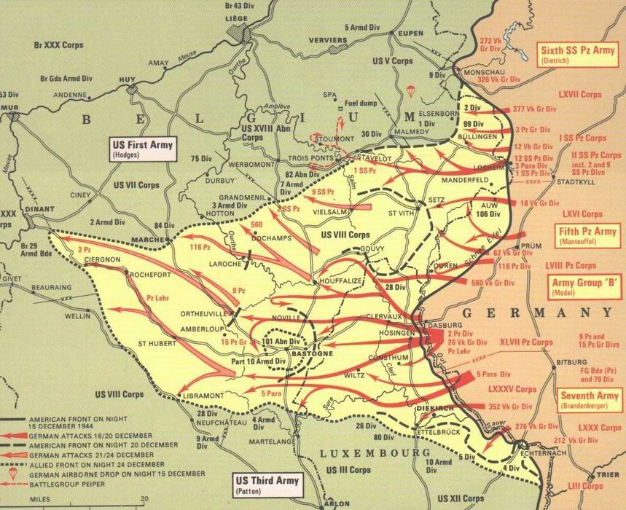
Map of the Battle of the Bulge
1

Slide 16
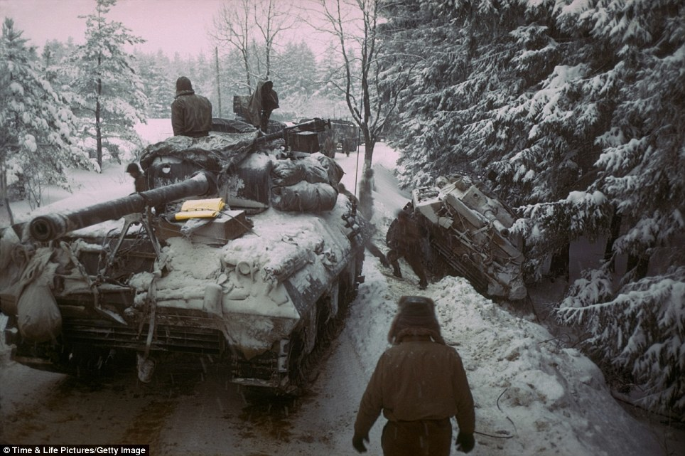
Winter in the Ardennes Forest
3

Slide 17
